Slide 1
CSE 105 – Structure Programming
Topic:
Reading Input
identifier,
if statement,
Arithmetic Operation

Slide 2
Reading Input
scanf is the C library’s counterpart to printf.
scanf requires a format string to specify the appearance of the input data.
Example of using scanf to read an int value:
scanf("%d", &i);
/* reads an integer; stores into i */
The & symbol is usually (but not always) required when using scanf.

Slide 3
Reading Input
Reading a float value requires a slightly different call of scanf:
scanf("%f", &x);
"%f" tells scanf to look for an input value in float format (the number may contain a decimal point, but doesn’t have to).

Slide 4
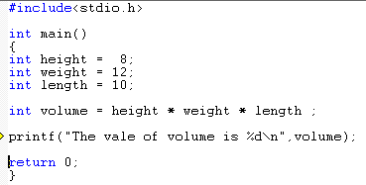
Computing volume of a Box

Slide 5
Computing volume of a Box
/* Computes the dimensional weight of a box from input provided by the user */
#include <stdio.h>
int main()
{
int height, length, width, volume;
printf("Enter height of box: ");
scanf("%d", &height);
printf("Enter length of box: ");
scanf("%d", &length);
printf("Enter width of box: ");
scanf("%d", &width);
volume = height * length * width;
printf("Volume (cubic inches): %d\n“,
volume);
return 0;
}

Slide 6
Computing volume of a Box
Sample output of program:
Enter height of box: 8
Enter length of box: 12
Enter width of box: 10
Volume (cubic inches): 960
Note that a prompt shouldn’t end with a new-line character.

Slide 7
Return value of scanf function:
int a, b, c;
printf(“Enter 2 Numbers:”);
c=scanf(“%d %d”,&a, &b);
printf(“returned value of scanf = %d\n”,c);
Sample Input:
Enter 2 Numbers: 10 20 Output: ??
Enter 2 Numbers: 20 A Output: ??
Enter 2 Numbers: A 20 Output: ??
Enter 2 Numbers: A B Output: ??

Slide 8
Identifiers
Names for variables, functions, macros, and other entities are called identifiers.
An identifier may contain
  letters,
  digits, and
  underscores,
  but must begin with a letter or underscore:
times10 get_next_char _done
It’s usually best to avoid identifiers that begin with an underscore.
Examples of illegal identifiers:
10times get-next-char

Slide 9
Identifiers
C is case-sensitive: it distinguishes between upper-case and lower-case letters in identifiers.
For example, the following identifiers are all different:
job joB jOb jOB Job JoB JOb JOB

Slide 10
Identifiers
Many programmers use only lower-case letters in identifiers (other than macros), with underscores inserted for legibility:
symbol_table current_page name_and_address
Other programmers use an upper-case letter to begin each word within an identifier:
symbolTable currentPage nameAndAddress
C places no limit on the maximum length of an identifier.

Slide 11
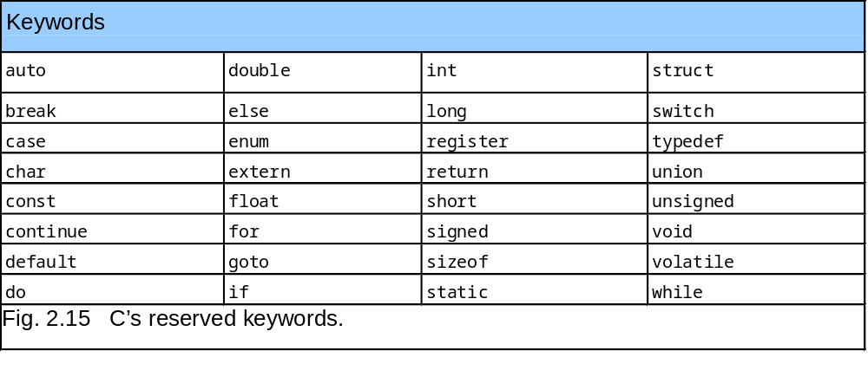
Keywords

Slide 12
Conditional Statement
If
If-else
If-else-if
Switch

Slide 13
The if Selection Statement
Selection structure:
  Used to choose among alternative courses of action
  Pseudocode:
    If your grade is greater than or equal to 60
    Print “Passed”
Pseudocode statement in C:
    if ( grade >= 60 )
    printf( "Passed\n" );
  C code corresponds closely to the Pseudocode/Flowchart

Slide 14
Flowcharts
Flowcharts is a graph used to depict or show a step by step solution using symbols which represent a task.
The symbols used consist of geometrical shapes that are connected by flow lines.
It is an alternative to pseudocoding; whereas a pseudocode description is verbal, a flowchart is graphical in nature.

Slide 15
Flowchart Symbols
Terminal symbol - indicates the beginning and
end points of an algorithm.
Process symbol - shows an instruction other than
input, output or selection.
Input-output symbol - shows an input or an output
operation.
Disk storage I/O symbol - indicates input from or output to disk storage.
Printer output symbol - shows hardcopy printer
output.

Slide 16
Flowchart Symbols cont…
Selection symbol - shows a selection process
for two-way selection.
Off-page connector - provides continuation of a logical path on another page.
On-page connector - provides continuation
of logical path at another point in the same
page.
Flow lines - indicate the logical sequence of
execution steps in the algorithm.

Slide 17
The if Selection Flowchart
if statement is a single-entry/single-exit structure
A decision can be made on any expression.
zero - false
nonzero - true
Example:
3 - 4 is true
true
grade >= 60
print “Passed”
false

Slide 18
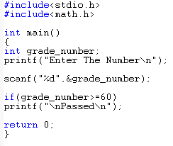



The if Selection Flowchart
if statement is a single-entry/single-exit structure
true
grade >= 60
print “Passed”
false

Slide 19
The if…else Selection Statement
if
  Only performs an action if the condition is true
if…else
  Specifies an action to be performed both when the condition is true and when it is false
Psuedocode:
    If student’s grade is greater than or equal to 60
    Print “Passed”
    else
    Print “Failed”
  Note spacing/indentation conventions

Slide 20



The if…else Selection Statement
Flowchart of the if…else selection statement
false
true
grade >= 60
print“Failed”
print“Passed”

Slide 21
Compound Statements
In the if statement template, notice that statement is singular, not plural:
if ( expression ) statement
To make an if statement control two or more statements, use a compound statement.
A compound statement has the form
{ statements }
Putting braces around a group of statements forces the compiler to treat it as a single statement.

Slide 22
Compound Statements
Example:
{ line_num = 0; page_num++; }
A compound statement is usually put on multiple lines, with one statement per line:
{
line_num = 0;
page_num++;
}
Each inner statement still ends with a semicolon, but the compound statement itself does not.

Slide 23
Compound Statements
Example of a compound statement used inside an if statement:
if (line_num == 15) {
line_num = 0;
page_num++;
}
Compound statements are also common in loops and other places where the syntax of C requires a single statement.

Slide 24
Relational Operators
C’s relational operators:
< less than
> greater than
<= less than or equal to
>= greater than or equal to
These operators produce 0 (false) or 1 (true) when used in expressions.
The relational operators can be used to compare integers and floating-point numbers, with operands of mixed types allowed.

Slide 25
Equality Operators
C provides two equality operators:
== equal to
!= not equal to
The equality operators produce either 0 (false) or 1 (true) as their result.

Slide 26
Arithmetic Operators
Addition + sum = num1 + num2;
Subtraction - age = 2007 – my_birth_year;
Multiplication * area = side1 * side2;
Division / avg = total / number;
Modulus % lastdigit = num % 10;
  Modulus returns remainder of division between two integers
  Example 5%2 returns a value of 1
Binary vs. Unary operators
  All the above operators are binary (why)
  - is an unary operator, e.g., a = -3 * -4

Slide 27
Arithmetic Operators (cont’d)
Note that ‘id = exp‘ means assign the result of exp to id, so
X=X+1 means
  first perform X+1 and
  Assign the result to X
Suppose X is 4, and
We execute X=X+1
4
5
X

Slide 28
Integer division vs Real division
Division between two integers results in an integer.
The result is truncated, not rounded
Example:
  int A=5/3; → A will have the value of 1
  int B=3/6; → B will have the value of 0
To have floating point values:
  double A=5.0/3; → A will have the value of 1.666
  double B=3.0/6.0; → B will have the value of 0.5

Slide 29
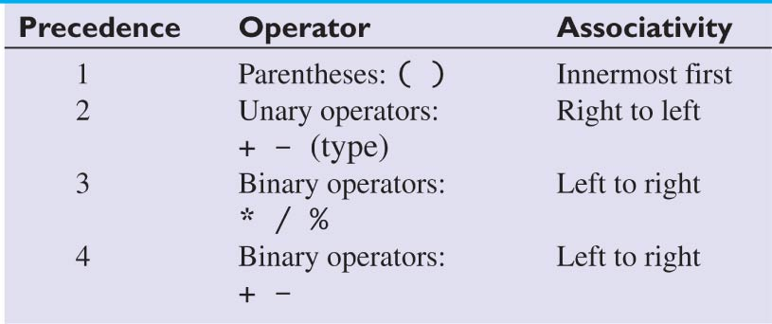
Precedence of
Arithmetic Operators
Mixed operations:
int a=4+6/3*2; → a=?
int b=(4+6)/3*2; → b=?
a= 4+2*2 = 4+4 = 8
b= 10/3*2 = 3*2= 6
5 assign = Right to left

Slide 30
Exercise
Compute the following
  2*(3+2)
  2*3+2
  6-3*2

Slide 31
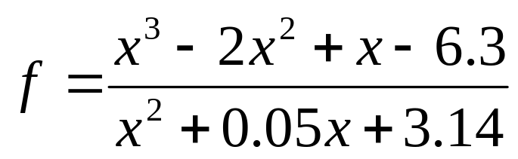
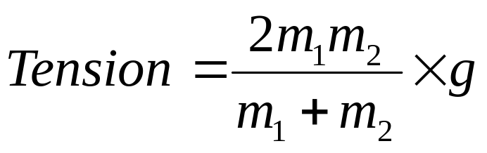
Exercise
Write a C statement to compute the following
f = (x*x*x-2*x*x+x-6.3)/(x*x+0.05*x+3.14);
Write a C statement to compute the following
Tension = 2*m1*m2 / m1 + m2 * g;
wrong
Tension = 2*m1*m2 / (m1 + m2) * g

Slide 32
Exercise: swap
Write a set of statements that swaps the contents of variables x and y
3
5
5
3
x
y
x
y
Before
After

Slide 33
Exercise: swap
First Attempt
  x=y;
  y=x;
3
5
5
5
5
5
x
y
x
y
x
y
Before
After x=y
After y=x

Slide 34
Exercise: swap
Solution
  temp= x;
  x=y;
  y=temp;
3
5
?
3
5
3
5
5
3
5
3
3
x
y
temp
x
y
temp
x
y
temp
x
y
temp
Before
after temp=x
after x=y
after y = temp

Slide 35
Exercise: reverse a number
Suppose you are given a number in the range [100 999]
Write a program to reverse it
For example,
num is 258
reverse is 852

Slide 36
Exercise: Arithmetic operations
Show the memory snapshot after the following operations by hand
int a, b, c=5;
double x, y;
a = c * 2.5;
b = a % c * 2 - 1;
x = (5 + c) * 2.5;
y = x – (-3 * a) / 2;
Write a C program and print out the values of a, b, c, x, y and compare them with the ones that you determined by hand.
?
?
5
?
?
a
b
c
x
y
a = 12 b = 3 c= 5 x = 25.0000 y = 43.0000

Slide 37
Exercise: Arithmetic operations
Show how C will perform the following statements and what will be the final output?
int a = 6, b = -3, c = 2;
c= a - b * (a + c * 2) + a / 2 * b;
printf("Value of c = %d \n", c);

Slide 38
Step-by-step show how C will perform the operations
c = 6 - -3 * (6 + 2 * 2) + 6 / 2 * -3;
c = 6 - -3 * (6 + 4) + 3 * -3
c = 6 - -3 *10 + -9
c = 6 - -30 + -9
c = 36 + -9
c = 27
output:
Value of c = 27

Slide 39
Math Functions
  #include <math.h>
  fabs(x) Absolute value of x.
  sqrt(x) Square root of x, where x>=0.
  pow(x,y) Exponentiation, x^{y}. Errors occur if
  x=0 and y<=0, or if x<0 and y is not an integer.
  ceil(x) Rounds x to the nearest integer toward ∞ (infinity).
  Example, ceil(2.01) is equal to 3.
  floor(x) Rounds x to the nearest integer toward -∞ (negative infinity). Example, floor(2.01) is equal to 2.
  exp(x) Computes the value of e^{x}.
  log(x) Returns ln x, the natural logarithm of x to the base e. Errors occur if x<=0.
  log10(x) Returns log10x, logarithm of x to the base 10.
  Errors occur if x<=0.

Slide 40
Trigonometric Functions
  sin(x) Computes the sine of x, where x is in radians.
cos(x) Computes the cosine of x, where x is in radians
  tan(x) Computes the tangent of x, where x is in radians.
  asin(x) Computes the arcsine or inverse sine of x,
  where x must be in the range [-1, 1].
  Returns an angle in radians in the range [-π/2,π/2].
  acos(x) Computes the arccosine or inverse cosine of x,
  where x must be in the range [-1, 1].
  Returns an angle in radians in the range [0, π].
  atan(x) Computes the arctangent or inverse tangent of x. The Returns an angle in radians in the range [-π/2,π/2].
  atan2(y,x) Computes the arctangent or inverse tangent of the value y/x. Returns an angle in radians in the range [-π, π].

Slide 41
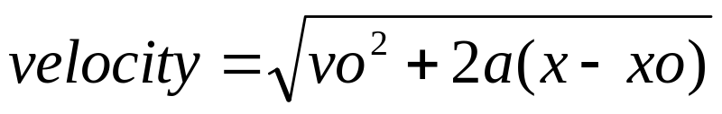
Exercise
Write an expression to compute velocity using the following equation
Assume that the variables are declared
velocity = sqrt(vo*vo+2*a*(x-xo));

Slide 42
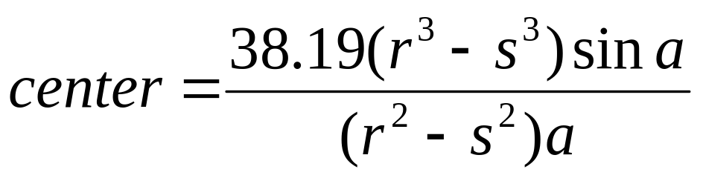
Exercise
Write an expression to compute velocity using the following equation
Assume that the variables are declared
center = (38.19*(pow(r,3)-pow(s,3))*sin(a))/
((pow(r,2)-pow(s,2))*a);

Slide 43
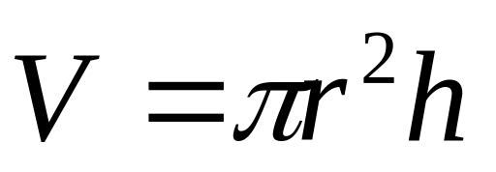
Exercise: Compute Volume
Write a program to compute the volume of a cylinder of radius r and height h
r
h

Slide 44
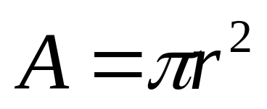
Exercise
Write a program to find the radius of a circle given its area. Read area from user. Compute radius and display it.
r

Slide 45

Questions or Suggestions

Slide 46

THANK YOU!

